Slide 1
Calibration of modern neural networks
Developed by Zongyuan Ge
Updated by Mitchell Hargreaves

Slide 2

Making a decision
Knowing how accurate a model is may not be good enough
Knowing the model’s confidence in a prediction can help
Camera sensor identifies [Plastic bag] [50% confidence]
Other sensors identify [Pedestrian] [90% confidence]

Slide 3
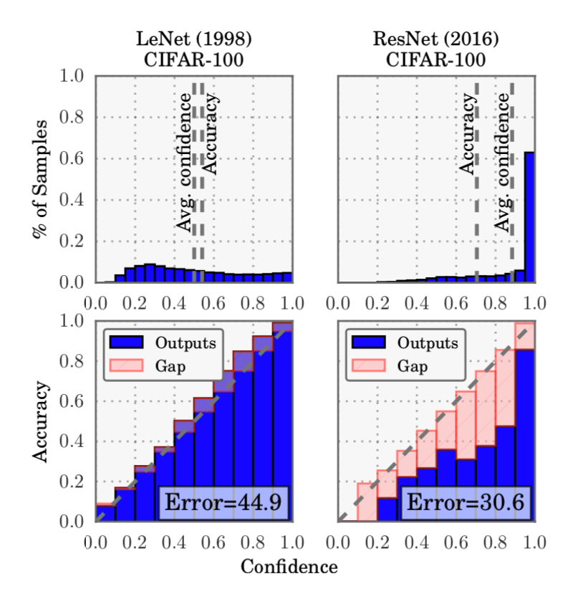

Slide 4
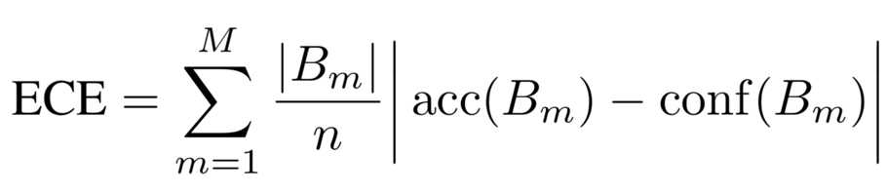
Expected Calibration Error
M = number of bins
n = total number of samples
B_{m} = samples for a bin
Divide up predictions into bins
ECE measures the difference between accuracy and confidence
ECE is a weighted average according to how many predictions are in each bin

Slide 5
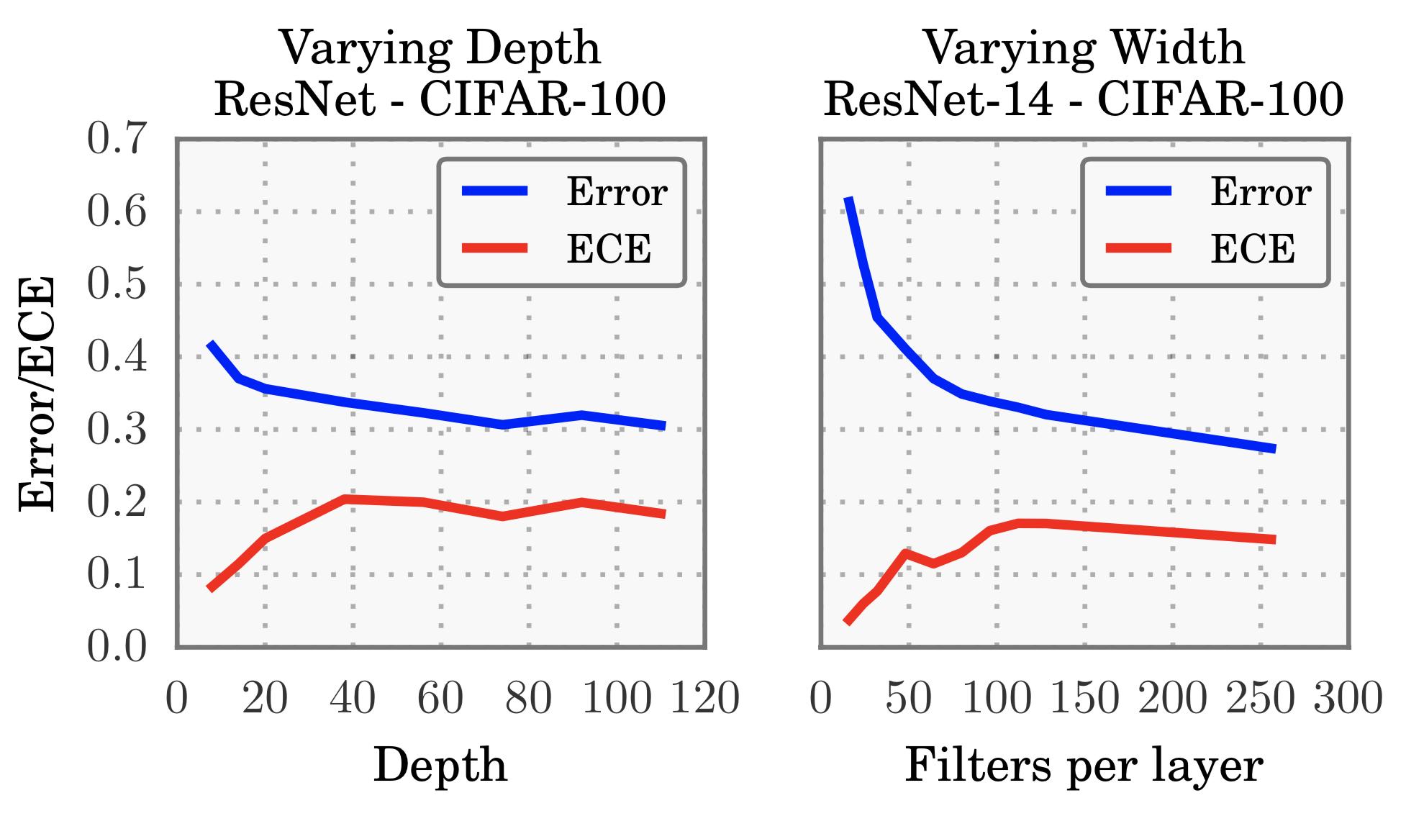

Slide 6
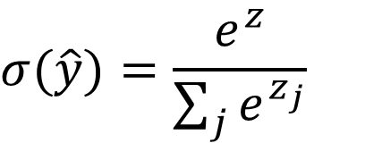
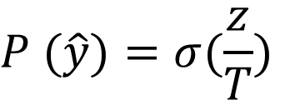
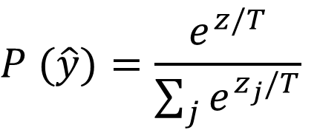
Temperature Scaling
Temperature Scaling is a simple post-processing technique for recalibrating networks
Rescales softmax input to tune confidence without affecting accuracy
It takes no extra data and very little extra code
ECE is a weighted average according to how many predictions are in each bin
$$P (\hat{y})=\frac{e^{z/T}}{\sum_{j}{e^{z_{j}/T}}}$$
Or using the definition of softmax…
$$σ(\hat{y})=\frac{e^{z}}{\sum_{j}{e^{z_{j}}}}$$
$$P (\hat{y})=σ(\frac{z}{T})$$

Slide 7
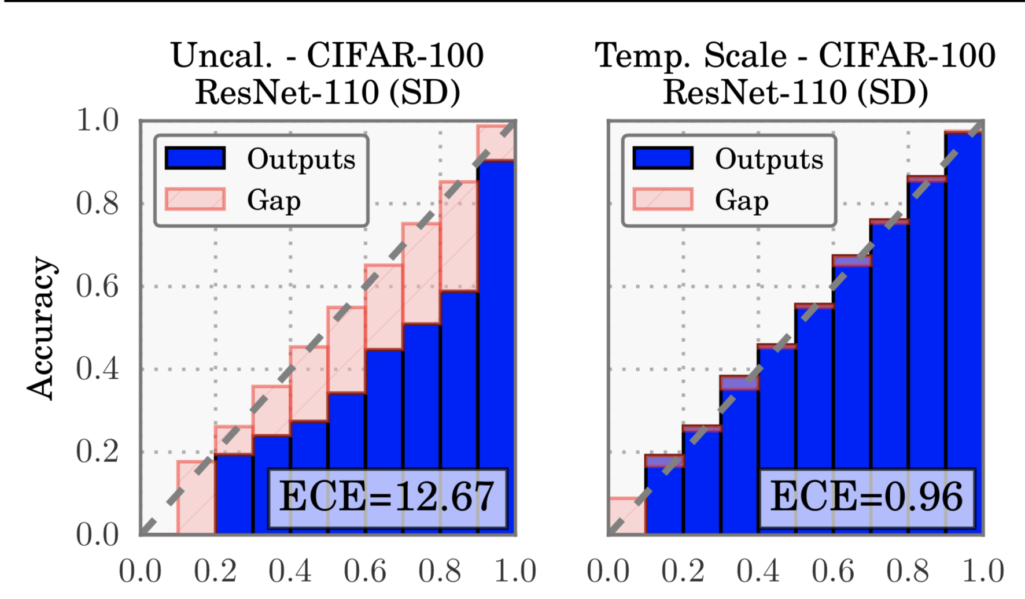

Slide 8
Home Work
Task 1: Build the basic elements for temperature scaling.
1-1: Write “softmax” function in “scaling_utils.py”
1-2: Write “predict” function in “temperature_scaling.py”
Task 2: Use TemperatureScaling class to calibrate the model
2-1: Write the code in function “model calibration” from “scaling_diagrams.py”
2-2: Conduct model calibration with learnt temperature
Task 3: Write ECE for model visualization
“ECE” function in “scaling_utils.py”

